Slide 1
Backend - TechStacks
Pravin Y Pawar

Slide 2
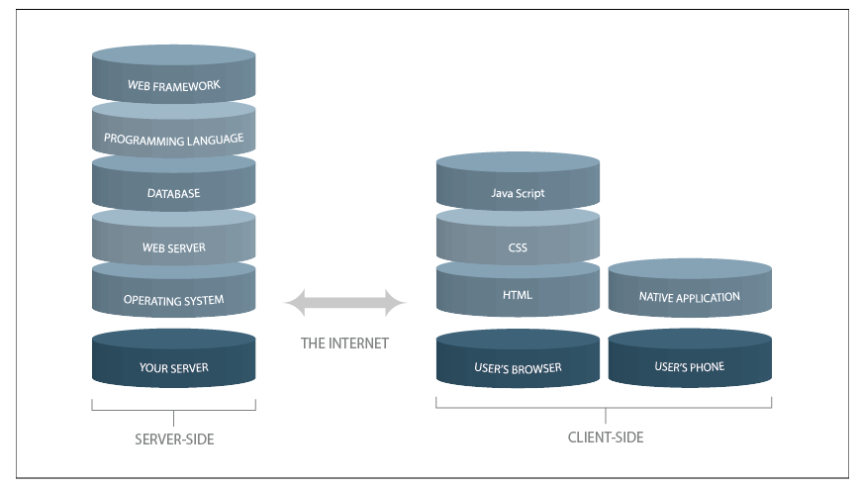
Tech stack
Is the combination of programming languages, tools and frameworks that the developers use to create web and mobile applications
Two main components to any application, known as client side and server side, also popular as front end and back end
A stack is created when one layer of application is built atop the other
with the help of codes and hardware modules ranging from generic to specific
A stack contains different layers of components/servers that developers use to build software applications and solutions
Image source : hackernoon

Slide 3
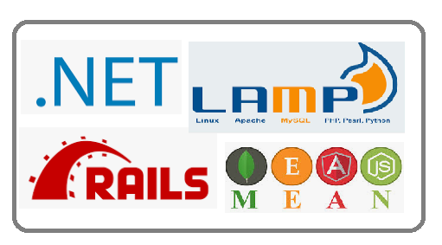
Tech stack
Deciphered
Client-side
Is where the real interaction with the user happens
The user will interact with the website, the web app or a mobile app depending on what he is using
Three main technologies in front end: HTML, CSS and JavaScript
Server-side
The back end consists of a server, an application (OS, Web server, Programming language, Web framework), and a database
Umbrella term used for websites where developers perform the following functions like
programming the business logic
server side hosting
app deployments
integrating with databases
Common Stacks
.net
LAMP
MEAN / MERN / MEVN / MEEN
RoR

Slide 4
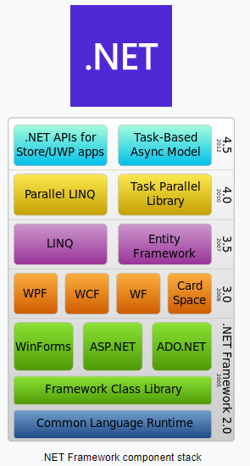
.net stack
Developed by Microsoft
Is a feature rich, thoroughly battle tested framework that lets to build dynamic and interactive web apps
Subset of Overflow Stack, a comprehensive tech stack that fulfils all the requirements of web front-end, database and .NET developers
C# language and .NET framework form the centerpiece
Capable of supporting a wide variety of applications
right from small scale server side web applications
to huge enterprise-level, transaction processing systems
.NET Stack has about 60 frameworks, platforms, SDKs, IDEs, SOA, libraries, etc. spread over 13 layers
Image source : wikipedia

Slide 5
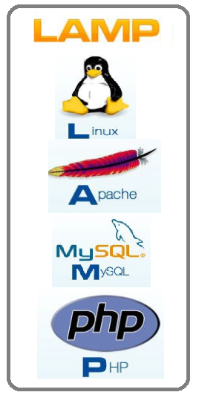
LAMP
Linux, Apache, MySQL, Python / Perl/ Php
Made of all open source software components is the one of the earliest stacks to get popular
The most traditional stack model around, and very solid
The main components are
Linux operating system,
Apache HTTP Server
MySQL RDBMS
PHP programming language
PHP is interchangeable with the languages Perl and Python.
Variations of LAMP include:
WAMP (Windows/Apache/MySQL/PHP): uses IIS server.
LAPP (Linux/Apache/PostgreSQL/PHP):uses PostgreSQL database variation that’s configured to work with enterprise-level projects
MAMP (Mac OS X/Apache/MySQL/PHP): Mac OS X operating system variation
XAMP (Linux, Mac OS X, Windows/Apache/MySQL/PHP, Perl): More complete bundle, and runs on Linux, Windows, and Mac operating systems

Slide 6
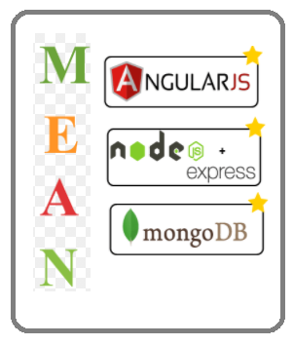
ME(A/R/V)N Stack
MongoDB, Express, Angular, Node
Open source, free Javascript software stack developers use for building dynamic web apps and websites
Supports MVC pattern
Components are
MongoDB — a NoSQL database
Express.js — a web app framework that runs on Node.js
Angular JS (or Angular) Javascript MVC framework that run in browser JavaScript engines
Node.js — an execution domain for event-driven server-side
Programs are coded in JavaScript - helps language uniformity
Makes it easier for developer working on the client side, understand the codes of the server side
Uses JSON for data transfer
The variation of MEAN include:
MERN: MongoDB, Express.js, React.js and Node.js
MEVN: MongoDB, Express.js, Vue.js and Node.js.
MEEN: MongoDB, Express.js, Ember.js and Node.js

Slide 7
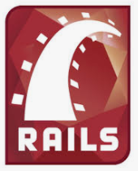
Ruby on Rails
Facilitates quick app development thanks to its rich repository of gems — library integrations
Highly scalable and it follows the ActiveRecord pattern
Compatible with MySQL on the back end.
Has its own built in database
Can abstract away the lower data base commands
Can write the codes in Active Record syntax and then swap it with lower level database specific queries
Useful when you don’t use too much database specific queries

Slide 8
Thank You!
In our next session:

